Slide 1
Prediction of Recovery Factor using Machine Learning Methods Dr. Munish Kumar and Kannapan Swaminathan
Match 2022

Slide 2
Disclaimer
ERC Equipoise Ltd (“ERCE”) has made every effort to ensure that the interpretations, conclusions and recommendations set out in this presentation are accurate and reliable in accordance with good industry practice. ERCE does not, however, guarantee the correctness of any such interpretations and shall not be liable or responsible for any loss, costs, damages or expenses incurred or sustained by anyone resulting from any interpretation or recommendation made by any of its officers, agents or employees.
This presentation is produced solely for the benefit of and on the instructions of ERCE’s client to whom it is presented, and not for the benefit of any third party. Any third party to whom the client discloses or makes available this presentation shall not be entitled to rely on it or any part of it.
All estimates of reserves and resources in this presentation are provisional and subject to change. The client agrees to ensure that any publication or use of this presentation which makes reference to ERCE shall be published or quoted in its entirety and the client shall not publish or use extracts of this presentation or any edited or amended version of this presentation, without the prior written consent of ERCE.
In the case that any part of this presentation is delivered in digital format, ERCE does not accept any responsibility for edits carried out by the client or any third party or otherwise after such material has been sent by ERCE to the client.
ERCE has used standard petroleum evaluation techniques in the preparation of this report. These techniques combine geophysical and geological knowledge with assessments of porosity and permeability distributions, fluid characteristics and reservoir pressure. There is uncertainty in the measurement and interpretation of basic data. ERCE has estimated the degree of this uncertainty and determined the range of petroleum initially in place and recoverable hydrocarbons. Our methodology adheres to the guidelines of the SPE PRMS, unless specifically instructed to do otherwise. The accuracy of estimates of volumes of oil and gas and production forecasts is a function of the quality and quantity of available data and of engineering interpretation and judgment. While estimates of Reserves and production forecasts, Contingent Resources and Prospective Resources presented herein are considered reasonable, these estimates should be accepted with the understanding that reservoir performance subsequent to the date of the estimate may justify revision, either upward or downward. In the estimation of future cash flows, ERCE has relied upon oil prices and contract terms assumed and provided by the client, which may not reflect future signed contract values. There is no guarantee that actual economic parameters will match the assumed values. The net present value (NPV) calculations presented in this report simply represent discounted future cash flow values. Though NPVs form an integral part of the fair market value estimations, without consideration for other economic criteria they are not to be construed as ERCE’s opinion of fair market value.

Slide 3
Motivation
Recovery Factor (RF) is one the most critical, and sometimes subjective, inputs towards determine field reserve → no clear approach to calculate or estimate given the variety of factors governing its value
Culmination of technical as well as non-technical aspects (analogs, experience based) and can consider both quantitative and qualitative parameters in its evaluation
Estimating Reserves
Analogs
Early Field Life
Volumetric
Early to Mid Field Life
Material Balance
Decline Curve Analysis
Late Field Life
Numerical Reservoir Simulation
Late Field Life
Late Field Life

Slide 4

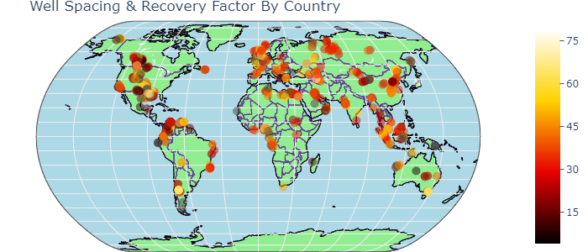


Objectives
Industrial Revolution 4.0 - This past decade has seen an explosion of machine learning (ML) and artificial intelligence (AI) methods, applied to almost all facets of life and in nearly all industries. O&G is no exception (robotics, IoT, advanced and predictive analytics etc)
Qn to answer: Can we predict RF → Investigate and understand variables that have an impact on Recovery Factor using ML and AI methods
Determine what parameters are important in RF prediction
Reduce the subjectivity of RF determination by proper parametrization of the problem
Determine and rank the effectiveness of different ML algorithms
Develop a technique where ERCE can “market” AI based solutions to client, or reduce the instances of client disagreement
Understand some of the ML and AI solutions being developed in literature and industry
Completely unstructured Dataset – open-source, global, both carbonate and sandstone reservoirs, all fluid types, including recovery mechanism. In total, data set has 342 columns and 1447 rows in total.
Categorical columns | Numerical columns | Total Size of Data Set | Total Number of Usable Data Points
226 | 115 | 494,874 | 194,241

Slide 5












Machine Learning Approach
Data Collection
Data Preparation
Choose Learning Algorithm
Train the Model
Test the Model
Deployment/ Evaluation on a “Blind” Data Set

Slide 6
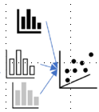

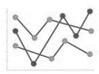





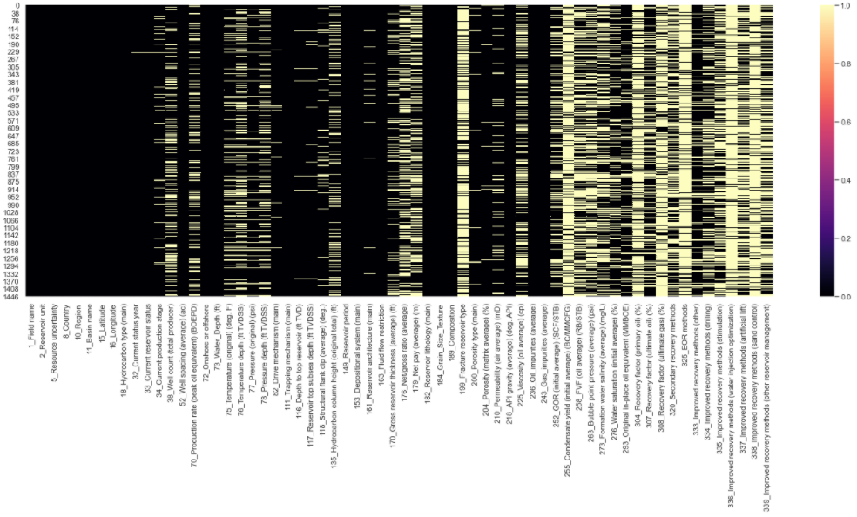
Data Collection & Data Preparation
Exploratory Data Analysis
&
Statistics, grouping of variables, determining nature of variables
Load Data
Attributes?
Uni/ Bi/ Multivariant/ Statistics?
Missing Values, Abberants, Outliers
Engineer the features
Drop Data based on criteria
Relabel
Data Cleaning
X | Y
a | b |  | Z
a | b |  | c
a | b |  | NAN
a | b |  | NAN
a | b |  | NAN
 |  |  | NAN
Most time-consuming process; involved removing duplicates, fixing indexes, replacing incorrect characters, normalization of names etc
Fill Missing with regression-based values using
Typically, data scientist use statistics to look for statistical patterns, fill values based on these “patterns”
A better alternative is to apply DOMAIN KNOWLEDGE where a RE/ Petrophysics will industry learnt relationships and apply them as regressional trends to create pseudo-data
The alternative to handle missing values is to DROP the missing variables. When this was done, we ended up with only 712 numerical data points or 0.37% of the original data set. .

Slide 7
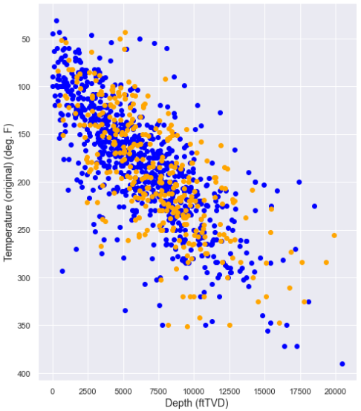
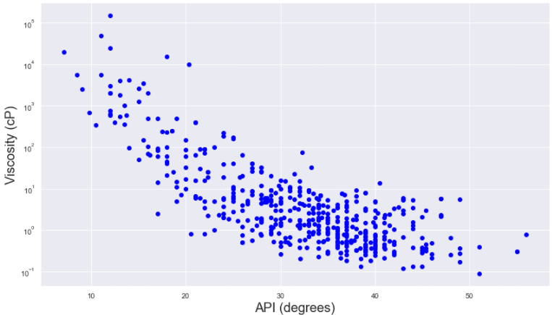

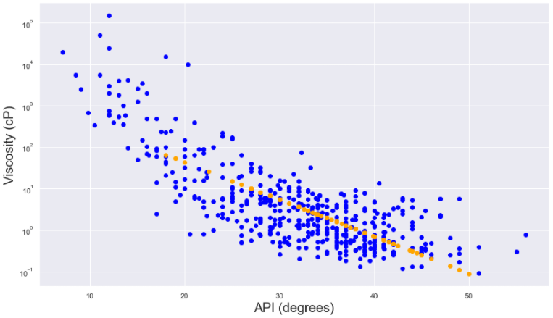
Domain Knowledge to fill Missing Values
Temperature-Depth Correlation
API-Viscosity Correlation (Sandstone, Oil)
Carbonate
Pre-fit
Sandstone
Post fit
~11% of the temperature values are missing. This can be corrected for using a “generalised” regression trend.
~20% of the viscosity values are missing. This can be corrected for with a correlation trend line between viscosity and API

Slide 8
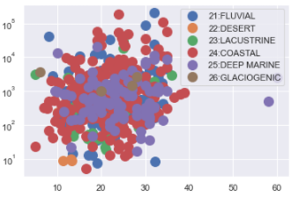
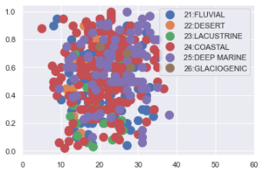
Domain Knowledge (Con’t)
Utilization of Regressions and relationships to fill Missing values
Temperature-Depth (Linear - Linear)
Pressure-Depth (Linear - Linear)
Porosity-Permeability (Linear - Log)
API-Viscosity (Linear-Log)
GOR-Pressure (Linear-Linear)
STOIIP-Porosity (Linear-Linear)
Reservoir Architecture (Categorical, Fill Missing with Mode)
Structural Dip (Numerical, Fill Missing with Average*)
Dummy Variables – Point Creation & Cumulative Scoring
Correlation ≠ Causality
Domain knowledge informs us that NTG & Porosity are independent variables required to evaluate STOIIP. Therefore, while the 2 plots look similar, correlation for one is possible, but makes no sense for the other (geologically).
STOIIP (MMstb)
NTG
Missing values in NTG cannot be corrected with porosity
Porosity (%)
Porosity (%)
* This column was later dropped as it made no difference to the model

Slide 9
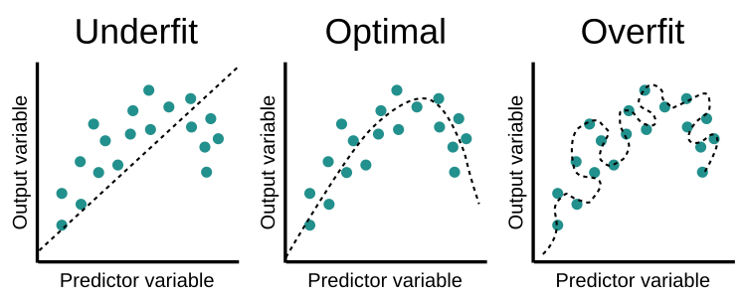
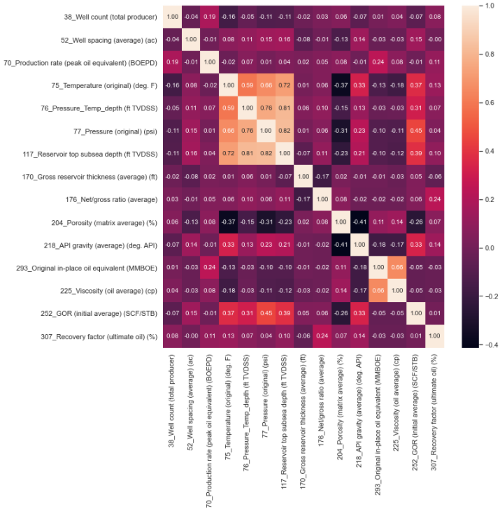
(Multi)collinearity
(Multi)collinearity is a condition where a predictor variable correlates with another predictor variable strongly. Therefore, changes in one of variable would cause changes in the other, giving a highly unstable end model.
Makes it difficult to determine which variables are significant if the model fluctuates greatly
Overfits your model because highly correlatable variables DOMINATE the output
Correlation Matrix – Pairwise Correlation
Highly correlatable values defined as having coefficients > 0.7.
From the plot, the following 3 parameters show collinearity and do not add additional information to the predictive model.
Temperature → Reservoir top subsea depth
Pressure_Temp_Depth → Reservoir top subsea depth
Pressure → Reservoir top subsea depth
Eliminating the data from “Reservoir top subsea depth” and “Pressure_Temp_Depth” will allow for a more stable model.

Slide 10
Final Data Inputs For ML Model
The following table shows the breakdown of the input variables used in the ML algorithm
Column | Type | Count | Unique | Top | Frequency | Mean | Standard Deviation | Min | 25% | 50% | 75% | Max
Region | Categorical | 436 | 7 | North America | 101
Basin Name | Categorical | 436 | 111 | North Sea | 27
Onshore/ Offshore | Categorical | 436 | 3 | Onshore | 270
Drive mechanism | Categorical | 436 | 4 | Aquifer Drive | 245
Reservoir period | Categorical | 436 | 23 | Crataceous | 124
Depositional system | Categorical | 436 | 6 | Coastal | 199
Reservoir architecture | Categorical | 436 | 7 | Layer-Cake | 261
(Avg) Well Spacing | Numerical | 436 |  |  |  | 83.0 | 217.6 | 0.0 | 0.0 | 30.0 | 89.3 | 3700.0
Temperature (Deg F) | Numerical | 436 |  |  |  | 175.0 | 54.0 | 31.0 | 138.8 | 173.5 | 208.1 | 334.0
Pressure (psi) | Numerical | 436 |  |  |  | 3514.7 | 2314.1 | 50.0 | 1825.8 | 3205.0 | 4479.0 | 13288.0
(Avg) Net/Gross Ratio | Numerical | 436 |  |  |  | 0.5 | 0.2 | 0.0 | 0.4 | 0.5 | 0.7 | 1.0
(Avg) Porosity (%) | Numerical | 436 |  |  |  | 21.6 | 6.4 | 5.0 | 17.0 | 21.7 | 25.6 | 38.0
(Avg) Air Permeability (mD) | Numerical | 436 |  |  |  | 758.0 | 1305.8 | 0.0 | 95.3 | 300.0 | 842.1 | 9000.0
(Avg) API gravity (deg API) | Numerical | 436 |  |  |  | 32.5 | 8.9 | 7.1 | 28.0 | 34.0 | 39.0 | 56.0
(Avg) Viscosity (cP) | Numerical | 436 |  |  |  | 719.9 | 7770.5 | 0.1 | 0.6 | 1.8 | 6.7 | 150000.0
(Avg) GOR (SCF/STB) | Numerical | 436 |  |  |  | 587.6 | 668.7 | 0.0 | 177.8 | 393.0 | 750.0 | 5019.0
Original in-place oil equivalent (MMBOE) | Numerical | 436 |  |  |  | 4296.7 | 16570.4 | 5.0 | 239.8 | 848.0 | 2705.0 | 213000.0
EOR/ IOR | Numerical | 436 |  |  |  | 4.9 | 2.0 | 0.0 | 4.0 | 5.0 | 6.0 | 9.0
Recovery factor (ultimate) (%) | Numerical | 436 |  |  |  | 39.1 | 15.0 | 5.5 | 29.0 | 39.0 | 49.0 | 78.4
Data set comprises of 7 categorical data types, and 12 numerical data types. The total data size is 436 per column, for a total of 8,284 data points (~4% of the original data base)

Slide 11

Machine Learning Approach
Data Collection
Data Preparation
Choose Learning Algorithm
Train the Model
Test the Model
Deployment/ Evaluation on a “Blind” Data Set

Slide 12
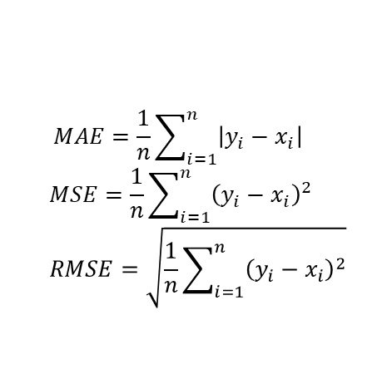
Running the ML algorithms
The choice of ML model is governed by the input parameters and the end objective.
We apply a supervised learning approach, splitting the raw inputs into a train-test set (70%-30% split). The “train” set is used to build the model, and the “test” set is used to test that the model works. We “validate” the model using a totally new, never-before-seen data set.
A total of 20 models were tested as a first pass; these models were ranked using the mean absolute error (MAE), the mean squared error (MSE) and the root mean squared error (RMSE).
Against outliers, the MSE and RMSE perform better
$$MAE=\frac{1}{n}\sum_{i=1}^{n}{\left|y_{i}−x_{i}\right|}$$
$$MSE=\frac{1}{n}\sum_{i=1}^{n}{{\left(y_{i}−x_{i}\right)}^{2}}$$
$$RMSE=\sqrt{\frac{1}{n}\sum_{i=1}^{n}{{\left(y_{i}−x_{i}\right)}^{2}}}$$
Where y_{i} is the prediction, x_{i} is the true value and n is the total number of data points.
The best 3 approaches are the Category Boosting (CatBoost), the Random Forest (RFR) and the Gradient Boosting Regressor (GBR).
Model | MAE | MSE | RMSE
CatBoost Regressor | 8.87 | 125.04 | 11.15
Random Forest Regressor | 9.39 | 135.10 | 11.61
Gradient Boosting Regressor | 9.66 | 141.37 | 11.87

Slide 13
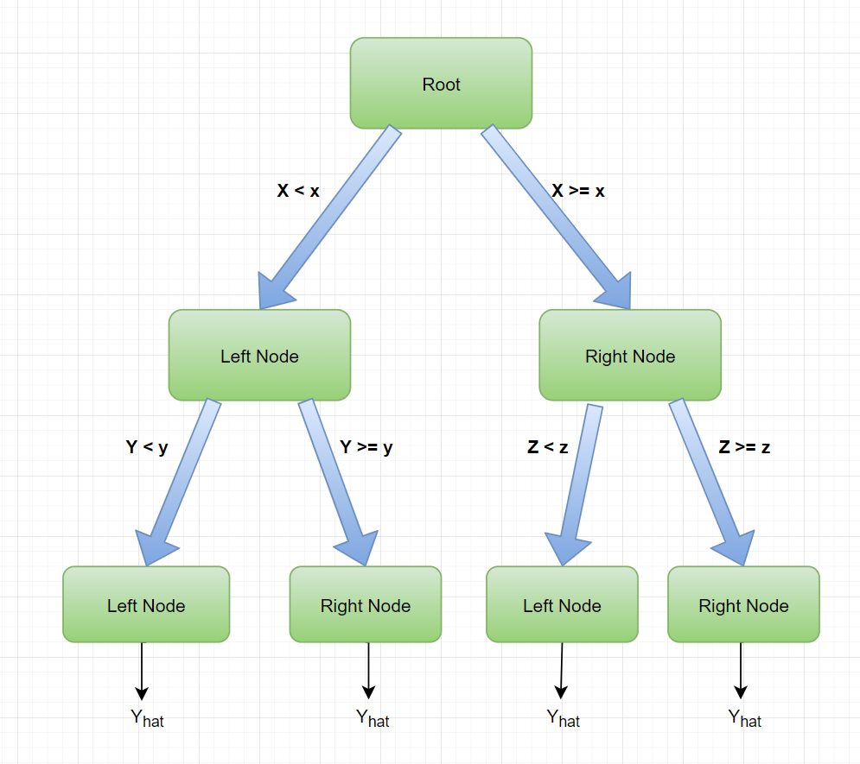
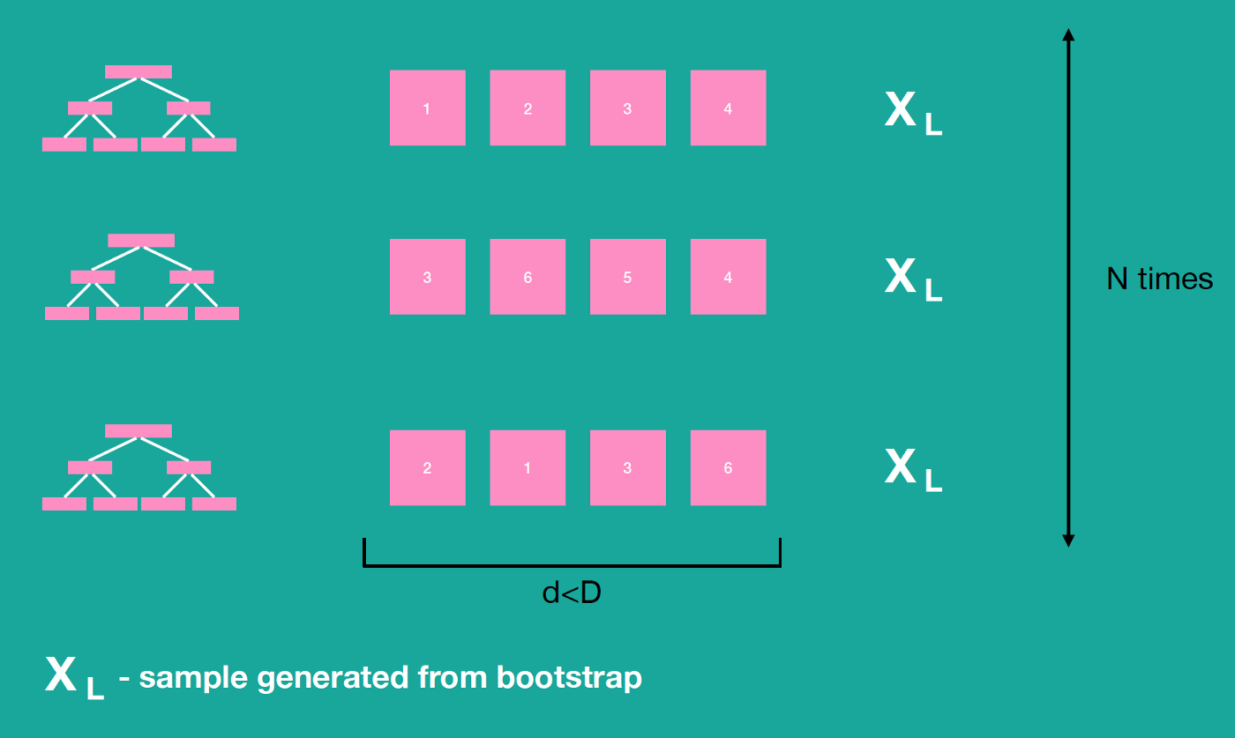
Differences in Algorithms
Fundamentally, all 3 algorithms are linked to decision trees
Decision trees can overfit, which is why it is necessary to either stop at a certain level or stop once the nodes reach a certain size (Stopping criteria). Alternatively, one can delete nodes (pruning).
The best method however is known as an “ensemble average” i.e., data set is split into numerous small sets (bootstrapping), a decision tree is created for each, giving N learned models (X_{L}), which can than be combined to give an improved model that is robust to overfitting and outliers.
CatBoost: Able to handle categorical as well as numeric data. Does this without requiring the conversion of categorical to dummy variables
RFR: Insensitive to outliers, works on large number of variables, hard to overfit, requires a lot of CPU memory.
Data Size D
Level = 3
Node = 2
boosting — weighted vote with a collection of classifiers, bagging — averaging the prediction over a collection of classifiers and stacking— combining a set of heterogeneous classifiers

Slide 14
Blending

Slide 15
Stacking

Slide 16
Tuning – Varying Hyperparameter

Slide 17
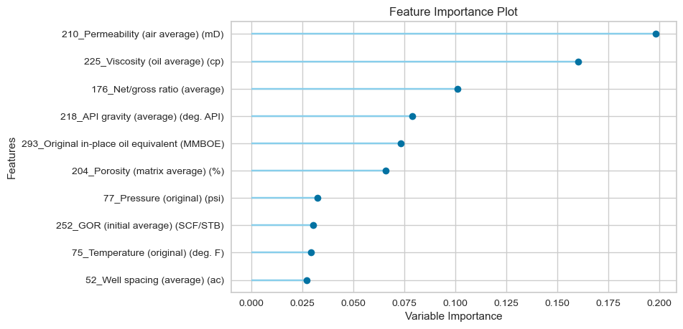
Final Solution – Gradient Boosting Regressor
Model | MAE | MSE | RMSE
Pre- Hyper Parameter Tuning
CatBoost Regressor | 8.87 | 125.04 | 11.15
Random Forest Regressor | 9.39 | 135.10 | 11.61
Gradient Boosting Regressor | 9.66 | 141.37 | 11.87
Post- Hyper Parameter Tuning

Slide 18
Machine Learning Approach
Data Collection
Data Preparation
Choose Learning Algorithm
Train the Model
Test the Model
Deployment/ Evaluation on a “Blind” Data Set

Slide 19
Deployment – Testing on a Blind Data Set

Slide 20
Conclusion

